Slide 1

Google Maps
Waze
VS
Many people need a navigation app to drive. This is because either there’s traffic, they are in a new place, there are one way streets or they are lazy. But which app is better to use? Which app seems to answer to their reviews, has better feedback, and has more positive stars?
Come for the ride and find out!
Even though they are both owned by google now….

Slide 2
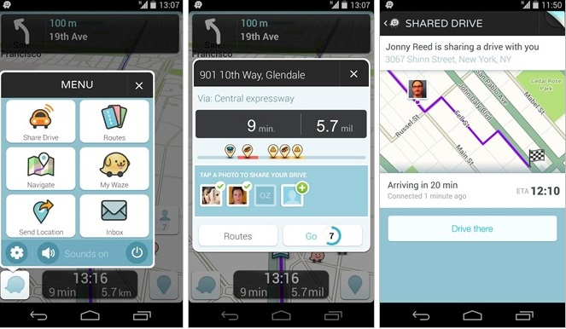


Building Selenium
Google Play Store
Shani Fisher is sharing her process with you
100th Selenium Ave
Steps:
90000…..
Start Scrapy
Run through the observations
Traffic:
Infinite Scroll
Button doesn’t press
Have to see button
Write the code
Ask friends for
help
Destination:
Got 5000 Reviews
of Waze App
Got 5000 Reviews
of Google Maps
Figure out errors
Get the finished project

Slide 3
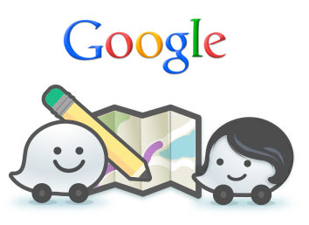

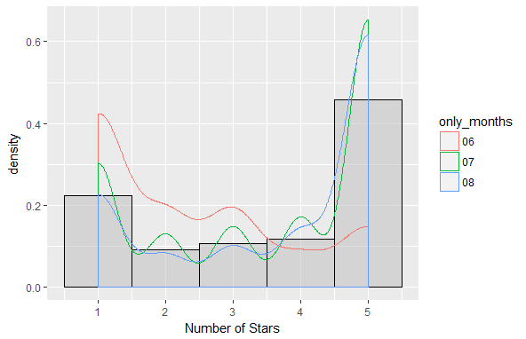
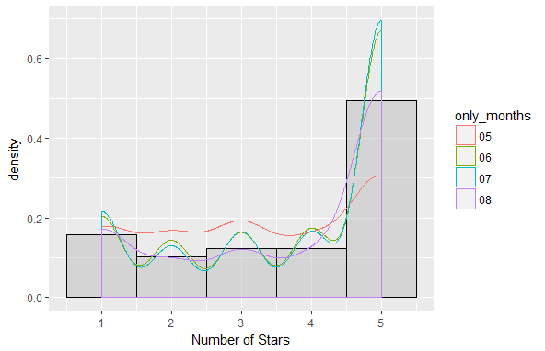

Google Maps
Waze

Slide 4
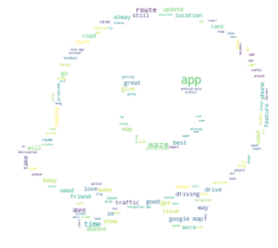
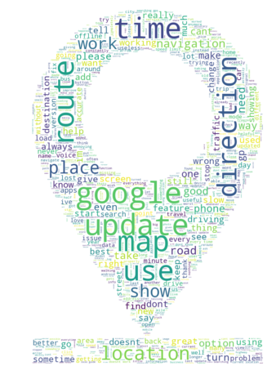
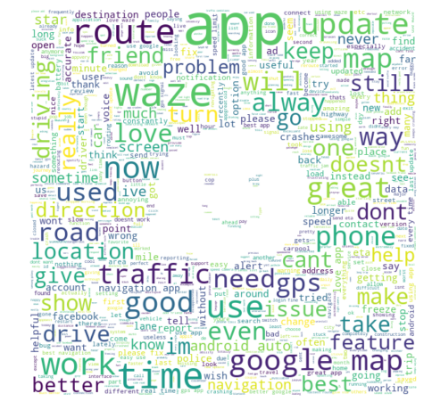
Word Clouds

Slide 5
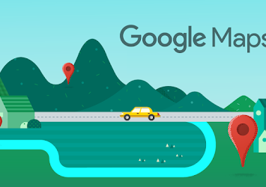
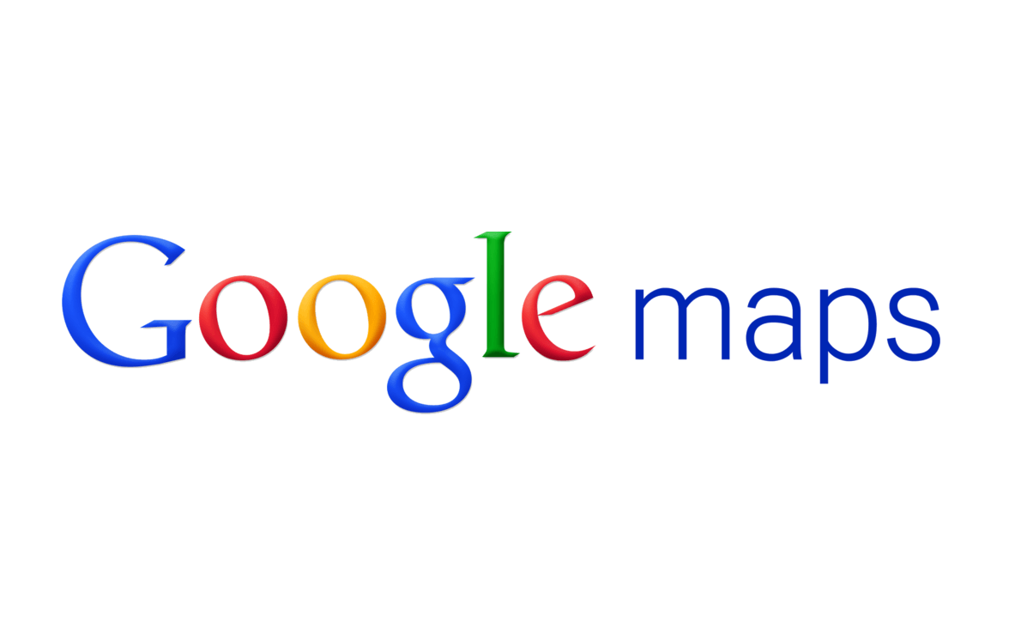

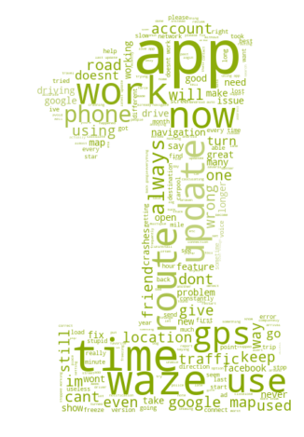
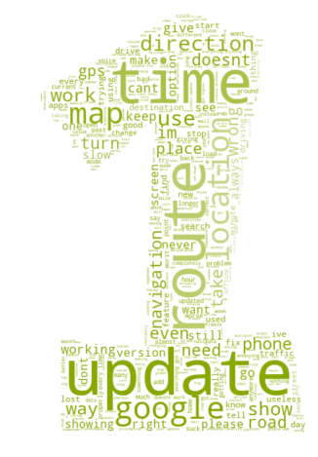
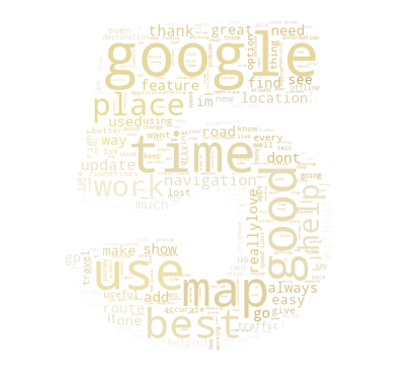
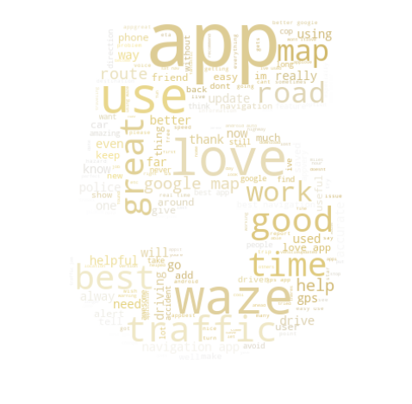
GPS
Time
Work
Update
Route
Time
Time
Place
Help
Traffic
Road
Time
Interesting that update is not so big here……

Slide 6
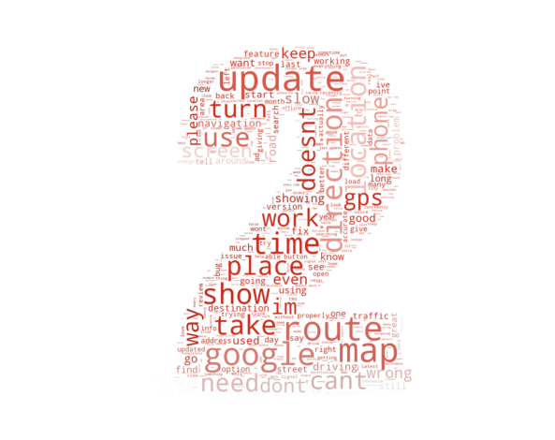
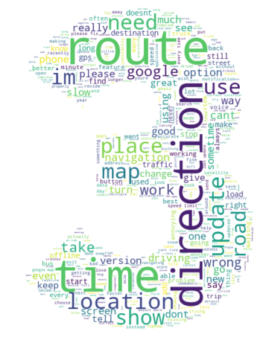
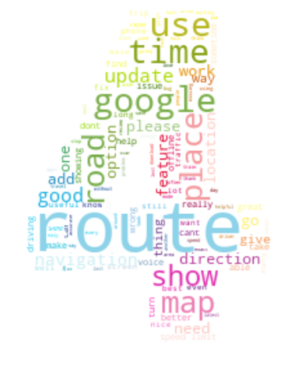



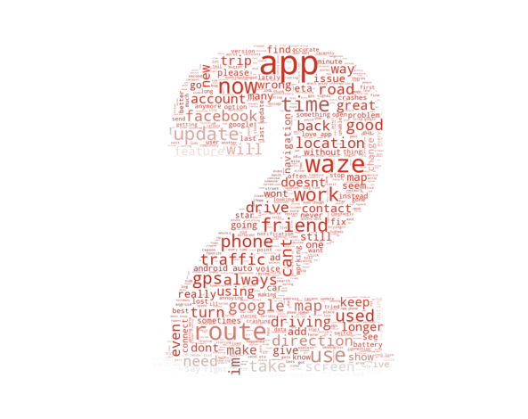
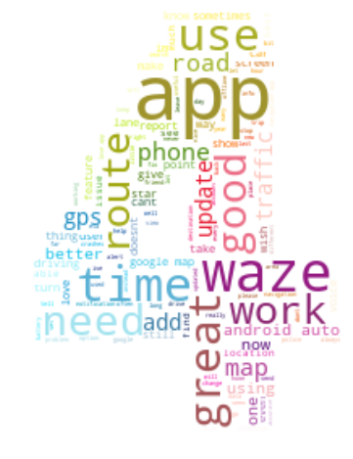
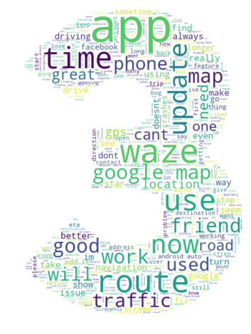


Update
Route
Doesn’t Work
Direction
Time
Location
Route
Time
Road
Work
Route
Friend
Friend
Update
Google Map
Update
Time
Route

Slide 7
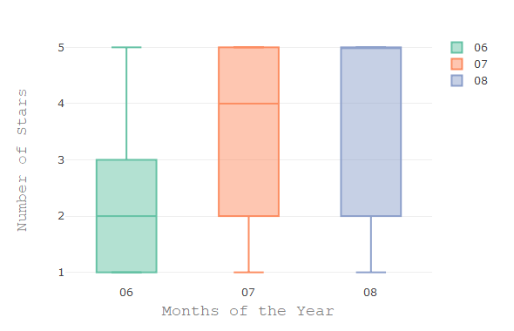
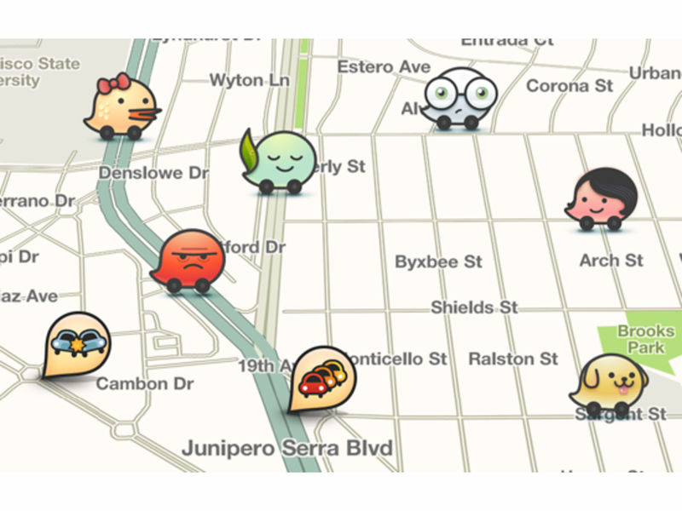
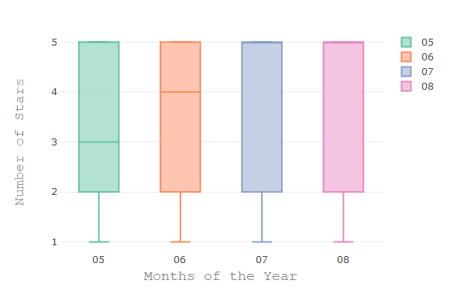
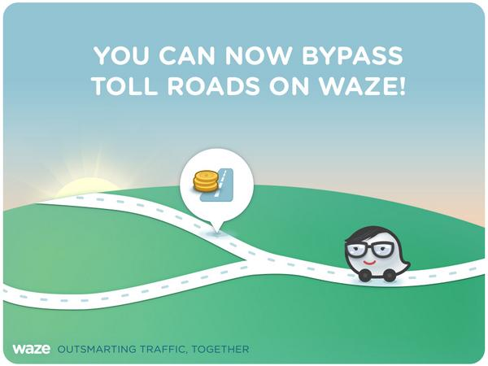
Google Maps
Waze

Slide 8
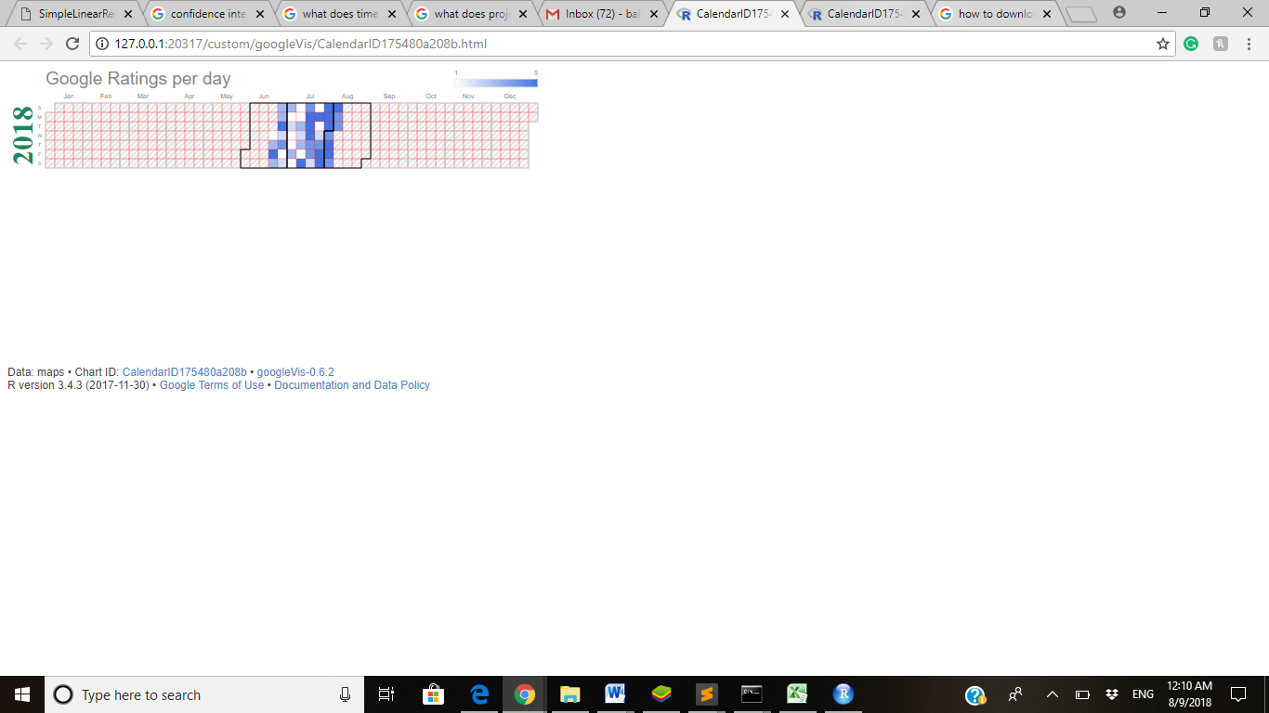
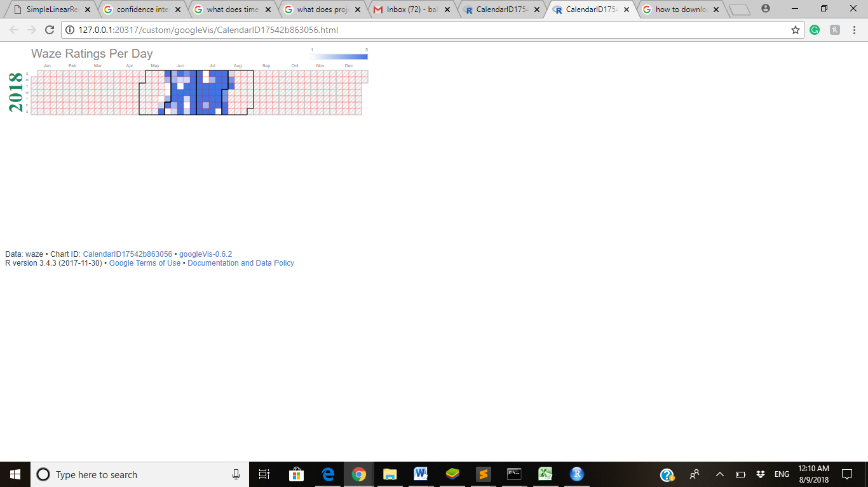
In the Future I would love to see more data but due to lack of time and the speed of Selenium 5000 reviews are only the dates for about 1 ½ - 2 ½ months.

Slide 9
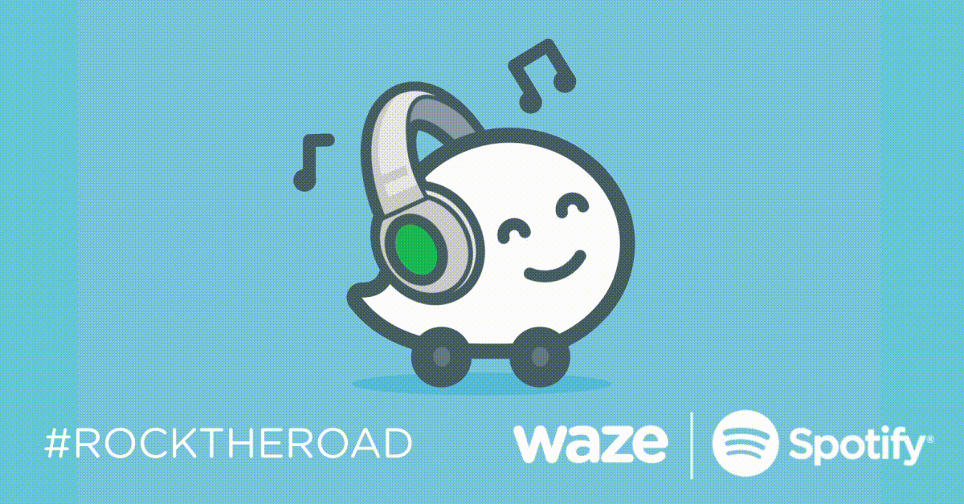
Do not forget to always drive safety……use whichever app you like better and write a review because it plays a role!
Enjoy and have a great day!
Questions!?!?

